Slide 1
MANAGEMENT INFORMATION SYSTEMS 1

Slide 2
Content
Business Intelligence
Competitive Intelligence
Qualities of Information

Slide 3

Business
Intelligence

Slide 4

Business – is an occupation or trade and the purchase and sale of products or services to make a profit.
Intelligence – the capacity to gain and apply knowledge.

Slide 5
Business Intelligence (BI)
– refers to skills, processes, technologies, applications and practices used to support decision making.
– is a broad category of applications and technologies for gathering, storing, analyzing, and providing access to data to help clients make better business decisions.

Slide 6
– Collective info about: customers, competitors, business partners, competitive environment, internal operations used to make: EFFECTIVE, IMPORTANT, STRATEGIC business decisions.

Slide 7







Why BI ?
What happened?
What is happening?
Why did it happen?
What will happen?
What do I want to happen?
Past
Present
Future

Slide 8
The Tools & techniques of business intelligence:
The major application includes the activities of:
–query and reporting,
–online analytical processing,
–decision support,
–data mining,
–forecasting,
–statistical analysis.
BI tools are divided into two major categories:
–(1) information and knowledge discovery
–(2) decision support and intelligent analysis.

Slide 9
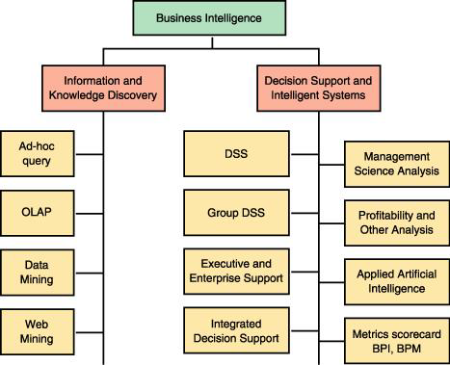
Categories of Business Intelligence:

Slide 10
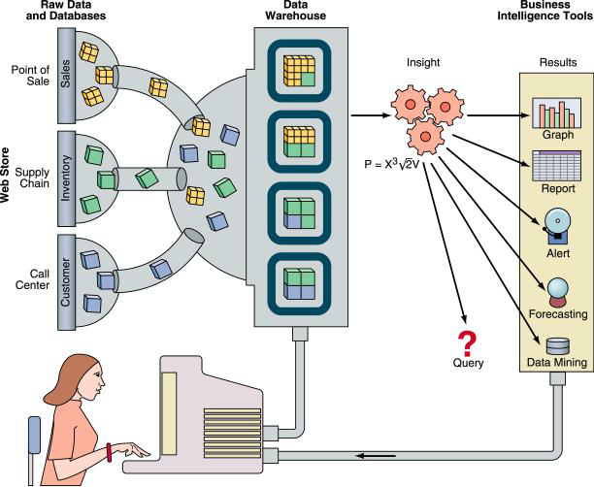
How does BI work?

Slide 11
BI applications and technologies can help companies analyze:
changing trends in market share
changes in customer behavior & spending patterns
customers' preferences
company capabilities
market conditions

Slide 12
Competitive
Intelligence

Slide 13
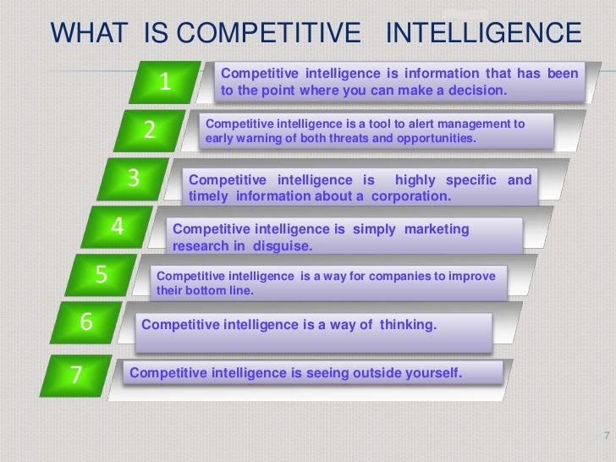

Slide 14
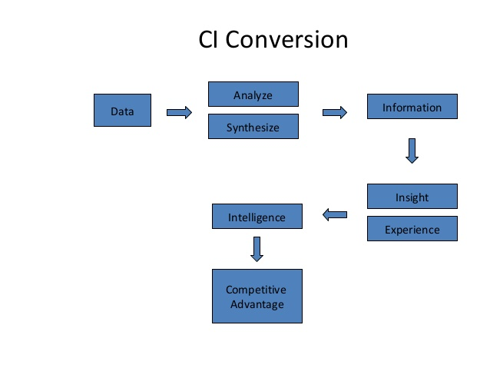

Slide 15
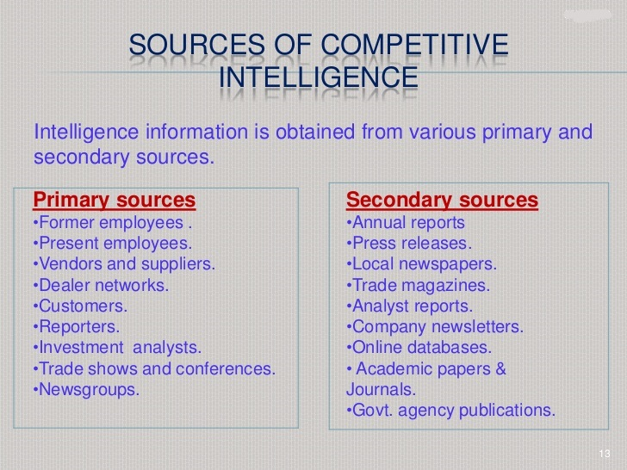

Slide 16
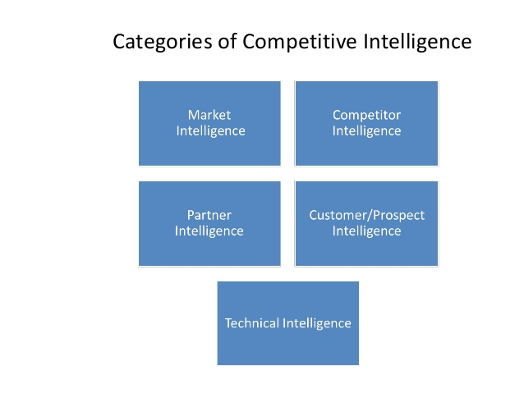

Slide 17
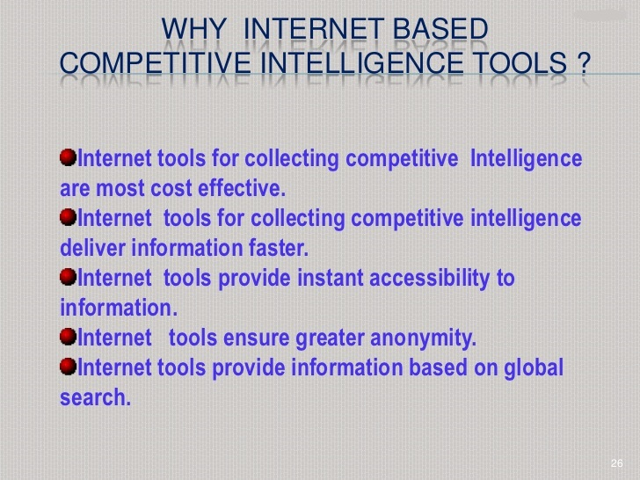

Slide 18
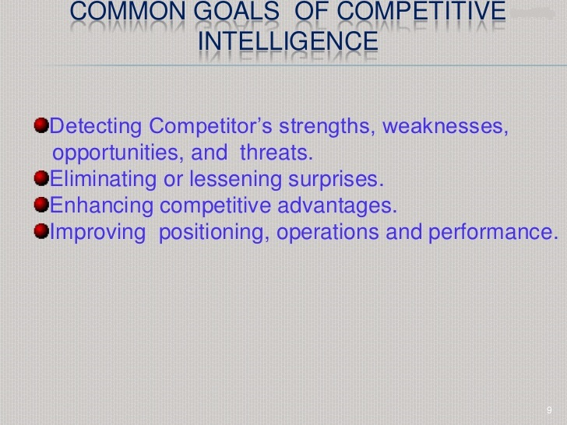

Slide 19
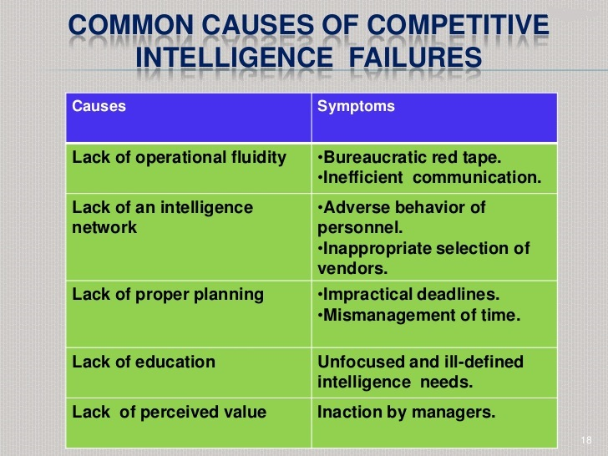

Slide 20
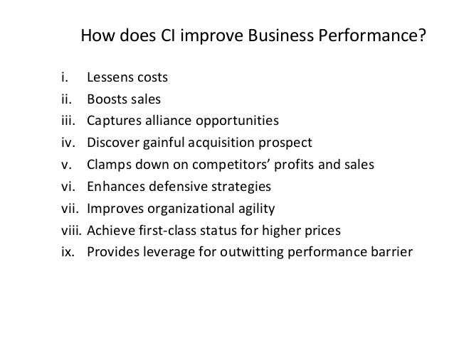

Slide 21
Qualities of Information

Slide 22
Timeliness
Timeliness – being at the right time.
–Do you have access to information when you need it?
–Does the information describe the time period you are considering?

Slide 23
Location
Location – a place where something is or could be located.
–Telecommuting, workplace virtualization, mobile
e-commerce …
–Having access to information sources.

Slide 24
Form
Form – the essence or state.
–Is the information in a form usable/useful for you? (Relevance & reliability)
•Audio, text, video, animation, graphical
–Is the information free from errors? (Integrity)
•Not defective

Slide 25
Validity
Validity – the state or quality of being valid.
–Credibility of information
–Did it pass a process of quality control by a standardizing organization?

Slide 26

HANK YOU……….
By: Jentzen Paolo A. Javier

